Slide 1
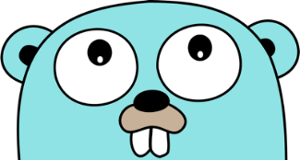
Learn Go Fast
With Riley

Slide 2
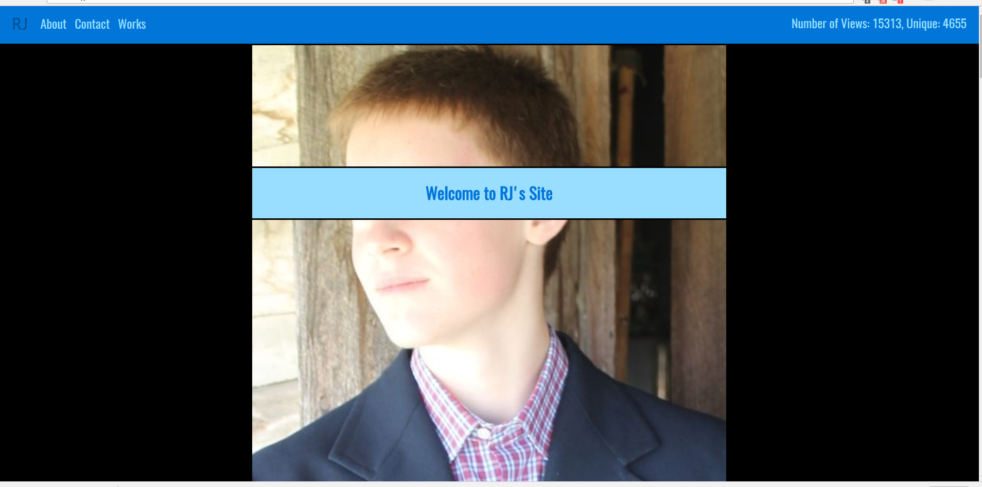
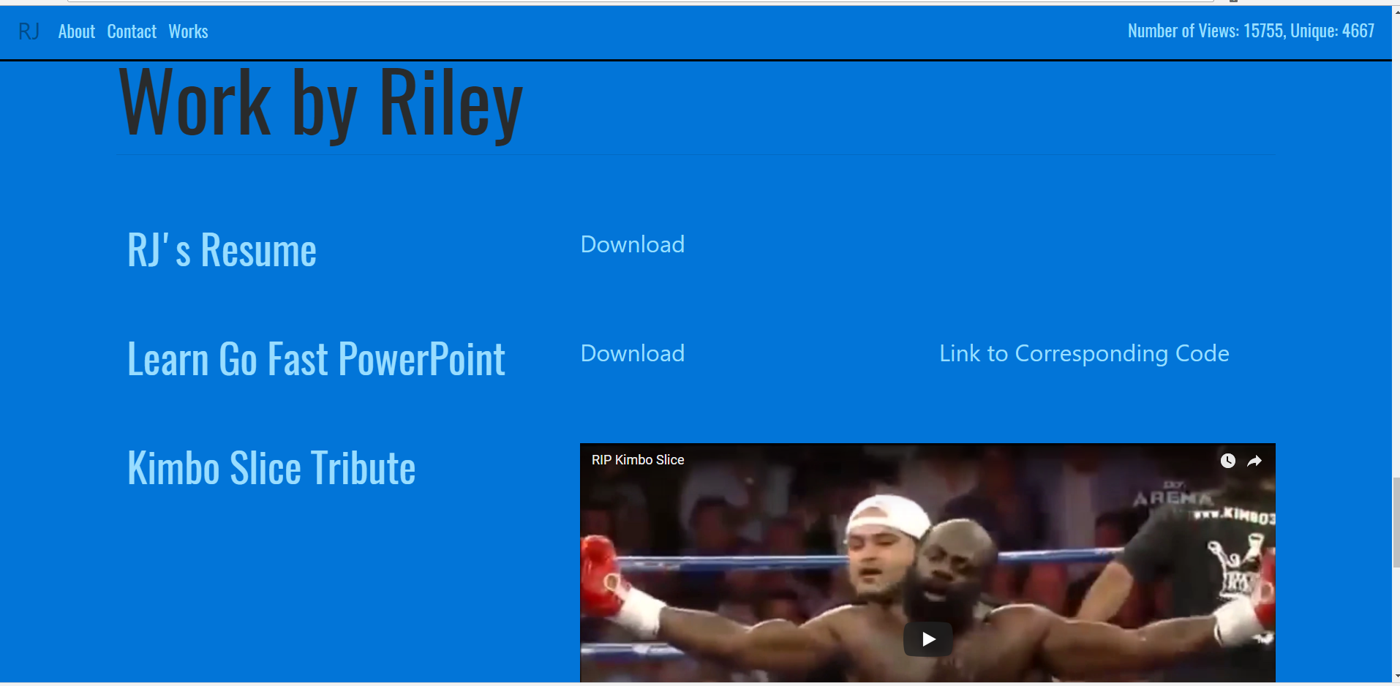
Before We Start
For those who want to follow along
https://play.golang.org/
Go Playground – Run Go code conveniently in the browser
The portion demonstrated will be executable in the playground, but won’t have the same effect as it would if ran locally
https://github.com/the-rileyj/Learn-Go-Fast
GitHub Repository – Has the Go code shown in this powerpoint and the powerpoint itself available at http://therileyjohnson.com under the works section
This presentation will be available within the next couple of days on my site as a video

Slide 3
Why learn GO?
Used by many companies and more every day
https://github.com/golang/go/wiki/GoUsers
Adobe
Google
YouTube
Netflix
Easy to Learn
Relatable to other languages with C based syntax
The number of keywords is relatively small, comparable to C
Simple in Structure and Concise in Practice
Portable
Concurrency Made Easy
Simple Back End for Web Development

Slide 4
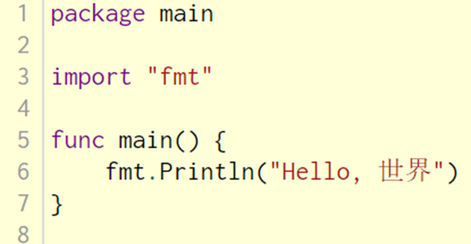
The Basics
1
Indicates that the file will be an executable
Tells that we want to import the “fmt” package
2
Declaration of the main function which is the program’s entry point
3
4
Prints out the text “Hello, 世界”
Required, “package” determines whether the .go file is an executable file with “main”, or is part of a package with the name of the package replacing “main” (think header in C or module in python)
Not required, “import” is only necessary to reference features from other packages, in this case the “fmt” package
Required for an executable, a non-”main” go file with a main function cannot be executed
Not required, main can contain 0 or more statements

Slide 5
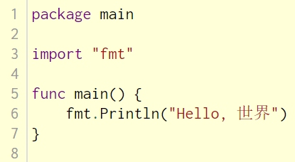
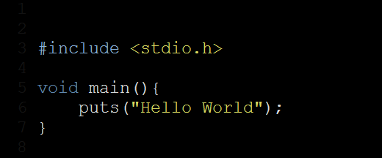
In Relation to C
1
2
3
In C, header files are used to enable code reusability; by including a header file you gain access to constants, macros, and functions otherwise not available. There is similar functionality in Go to include functions, types, and constants using “import” to gain access to another package.
As with C, this is the declaration of the main function, the entry of the program
The “puts” function in C prints out the string given to it and appending a trailing newline, the “fmt.Println” function in Go does the same thing with a single String argument, though will print out any arguments passed to it and print

Slide 6
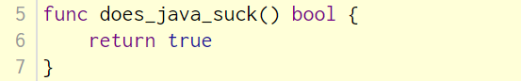
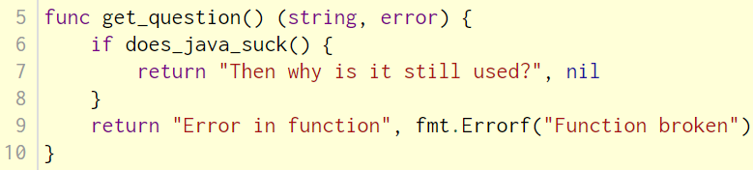
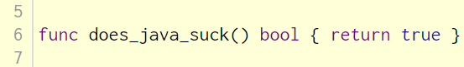
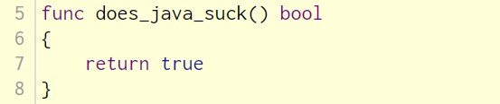
Beware
1
3
2
4
Go does not require semicolons at the end of single statements, though are required on lines where there is more than one statement occurring
In effect, newlines following certain keywords/characters are converted into semicolons, therefor the placement of newlines matter in the parsing of Go code
Parenthesis are not needing in if, switch, for, and select* statements
Braces are required however, even if the following statement is only one line

Slide 7
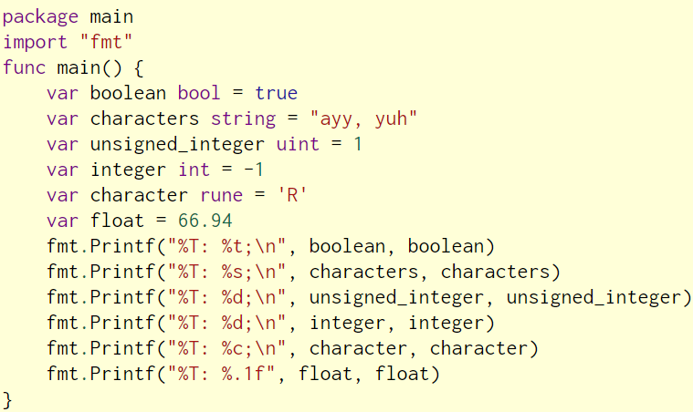
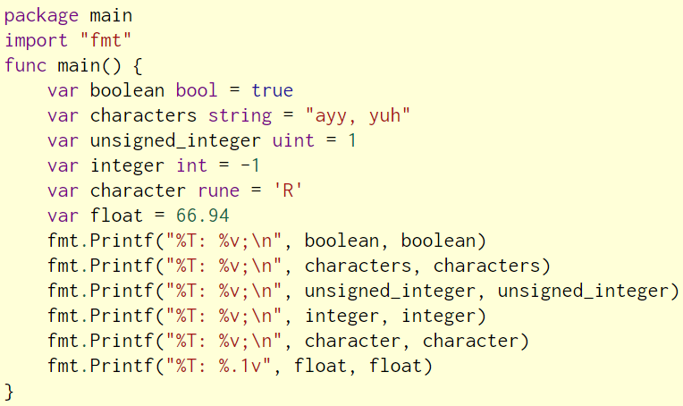
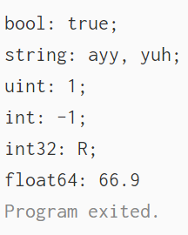
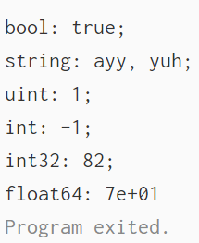
Basic Data Types*
1
Output:
Output:
2
3
4
5
6
bool – “%t” – true or false
string – “%s” – sequence of characters
int – “%d” – int8, int16, int32, int64 – range of positive and negative integers
uint – “%d” – uint8, uint16, uint32, uint64 – range of positive integers including 0
rune – “%c” – alias for int32, referred to as “char” in other languages, holds a single character
float – “%f” – float32 float64 – floating point number, decimal values

Slide 8
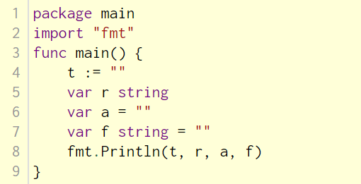
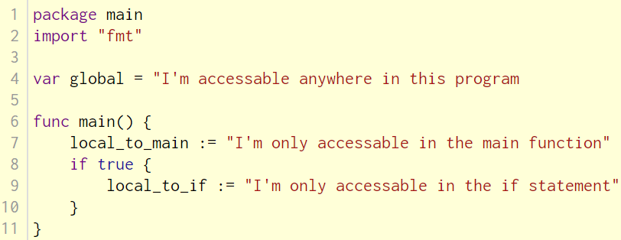
Variables; Declaration and Scope
1
5
2
3
4
Declaration can be explicit or implicit
All variables declared must be used – can’t compile otherwise
Variables not explicitly initialized with a value will be implicitly initialized with the type’s corresponding zero value; false for bool, “” for string, 0 for int, 0 for uint, ‘’ for rune , 0.0 for float
PLEASE use one of those first two declarations
Variables can be declared globally, locally within a function, or locally within a statement of sorts (if statement in this case)

Slide 9
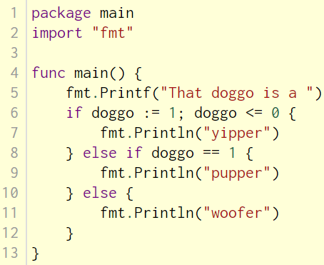
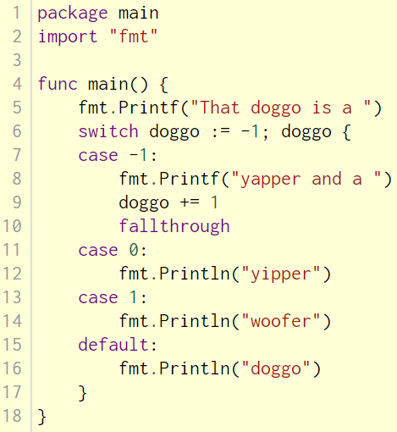
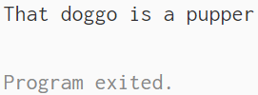
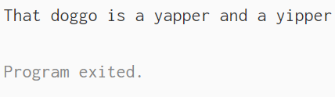
Flow Control
1
Output:
2
Output:
2
3
3
4
5
If the condition is true, then execute the code in the first pair of opening and closing braces; else if the second condition is true (and the first wasn’t), then execute the code in the second pair of opening and closing braces; else execute the code in the last pair of opening and closing braces
As mentioned earlier, parentheses are not necessary around the condition, opening closing braces are necessary regardless of the number of following statements
Local declaration can happen before an if or switch statement, though a semicolon is required to separate the variable declaration and the condition; note, the variable will only be accessible within the statement if it’s being declared there
If the variable being “switched” is equal to value, execute this code and continue the program
Note, switch statement does not require a “break” as with other C-like languages, to emulate that behavior, use a fall through statement at the end of the switch section you wish to fall through into the next one

Slide 10
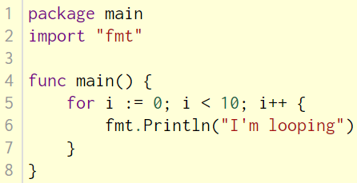
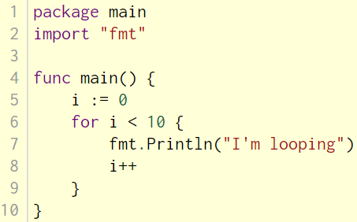
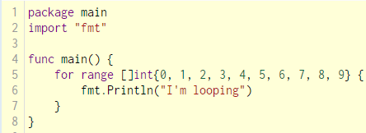
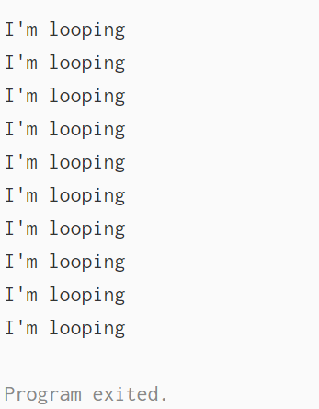
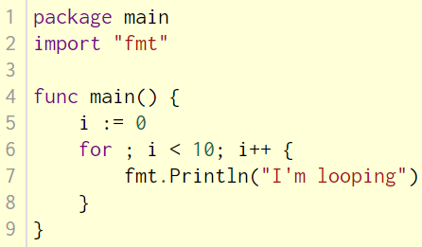
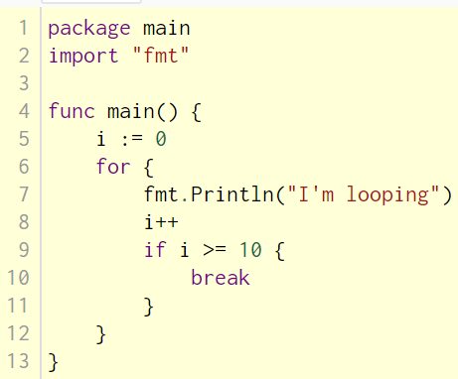
Looping
1
1
4
Output:
2
1
1
3
There is only one loop in Go, the “for” loop
Consists of initialization, condition, and incrementor
Though all three can be omitted; omission of the incrementor creates a “while” loop, omission of all three creates an infinite loop
For range loop can be used in a similar fashion

Slide 11
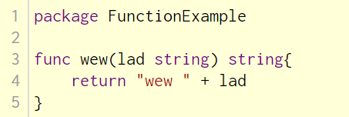
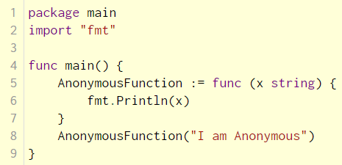
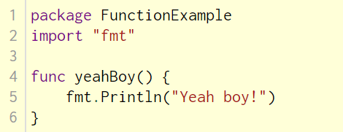
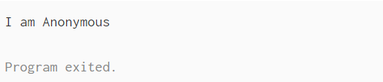
Functions
1
4
6
Output:
2
5
3
1
4
2
5
3
“func” name(x string) string { return “Hi “ + x } , required, the declaration of a function itself
func “name”(x string) string { return “Hi “ + x } , required (unless anonymous), the name of the function
func name(“x string”) string { return “Hi “ + x } , not required, parameters to be used in the function
func name(x string) “string” { return “Hi “ + x } , not required, the return type; the omission of a return type indicates that no value will be returned
func name(x string) string “{ return “Hi “ + x }” , required, the function body, the code which will be executed when the function is called
Anonymous functions exist in Go; an Anonymous function is just a function stored in a variable and not in a program file

Slide 12
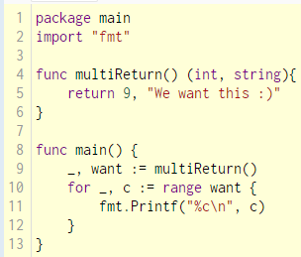

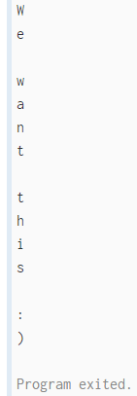
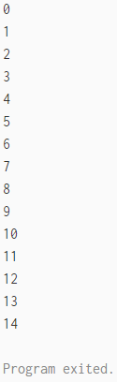
Variadic Return, Ignoring a Return Value
1
Output:
1
Output:
3
2
2
Go allows for more than one return value, though when specifying more than one return value in a function, parentheses are required
Unwanted return values can be ignored by using the blank identifier “_”
For range usually returns the index, then the value of the current index in the object being looped over, however if both are omitted, then it simply loops a number of times corresponding to the size of the object being looped over

Slide 13
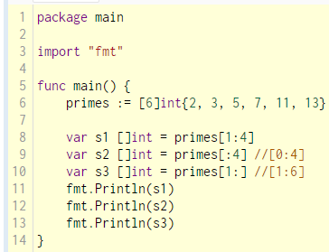
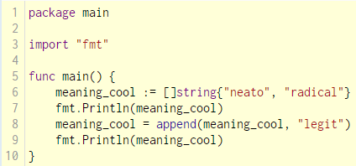
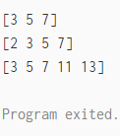
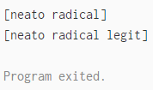
Arrays and Slices
Output:
Output:
Arrays in Go are similar to arrays in C, in that they are of fixed size (and can’t be resized) and hold a single type
An array's length is part of its type, so arrays cannot be resized
A slice is a dynamically-sized, flexible view into some or all elements of an array; in Go, slices are much more common than arrays
Accessing multiple values is done with the slice operator “:” inside of the accessing brackets of the slice

Slide 14
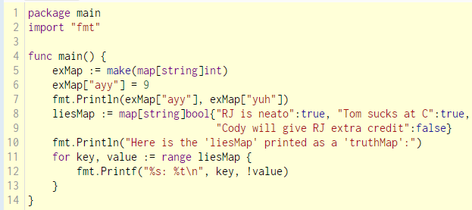
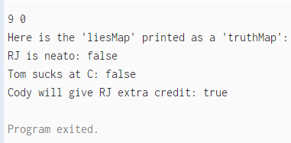
Maps
1
Output:
2
3
4
A map data type maps keys to values
Default value of a map key which is not been set yet, is the zero value for that data type, 0 in this case
Can be printed out using a for range loop to access the corresponding keys and values
Created either via the map function (seen first with “exMap”) or a map literal (seen second with “liesMap”)

Slide 15
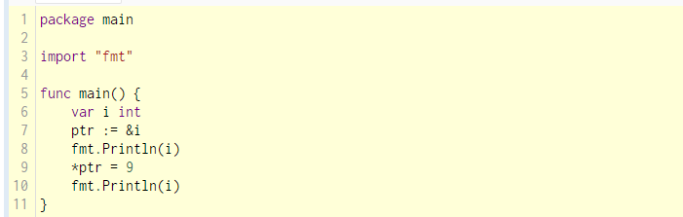
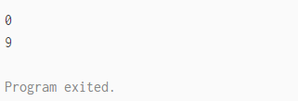
Pointers
Output:
A pointer is a variable which holds the memory address of another variable, allowing the pointer to access that variable’s value indirectly
The ‘&’ (reference) operator returns the memory address of the variable it’s operating on
The ‘*’ (dereference) operator returns the value of the memory address that the pointer holds
Note: Unlike C, Go has no pointer arithmetic

Slide 16
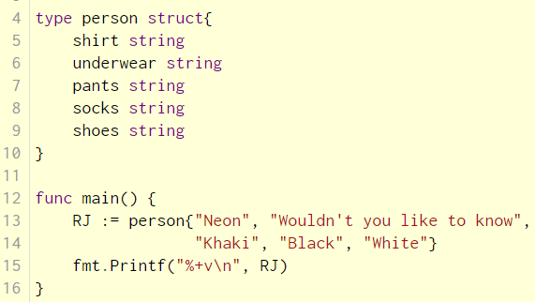
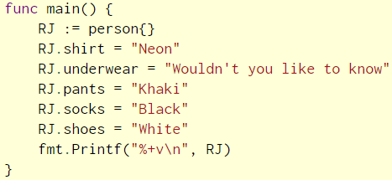
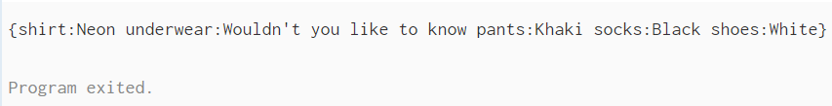
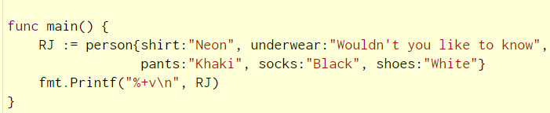
Structs
Output:
A struct is a data type that groups together zero or more named values of arbitrary types as a single entity
Each value in the struct is called a field
Instantiation of a struct can take many forms
Note, that like variables declared without a value, struct fields declared without a value are initialized with the type’s corresponding zero value

Slide 17
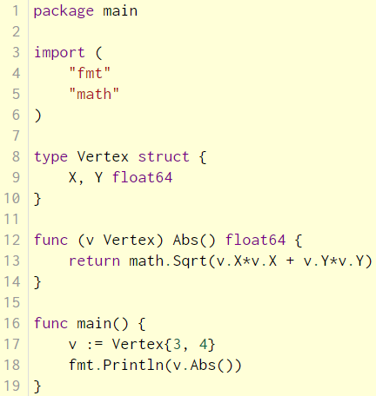
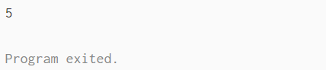
Methods
Output:
From: https://tour.golang.org/methods/1
Go does not have classes. However, you can define methods on types; a method is a function with a special receiver argument; the receiver appears in its own argument list between the “func” keyword and the method name specifying the type the method applies to

Slide 18
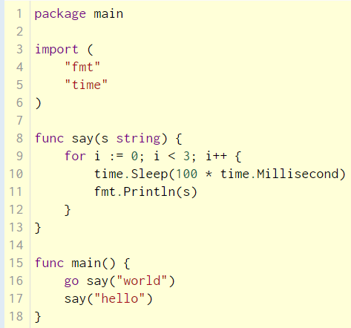
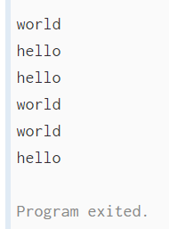
The “go” Statement
Output:
In Go, each concurrently executing activity is called a goroutine (Though you can think of them as threads for all intents and purposes). When a program starts, its only goroutine is the one that calls the “main” function, so we call it the “main goroutine”
Syntactically, a “go” statement is an ordinary function or method call prefixed by the keyword “go”
As soon as the main function returns, all other goroutines are abruptly terminated and the program exits

Slide 19
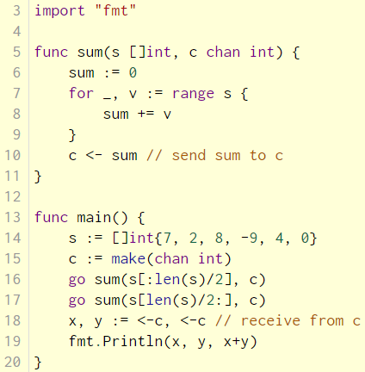


Channels
Output:
Channels are a typed conduit through which you can send and receive values with the channel operator “<-”
Channels will block until they receive values
Declared with the “make” function
Can be buffered, so the channel will block until the buffer is filled

Slide 20


Select
The “select” statement lets a goroutine wait on multiple channels at once
Will execute code corresponding to the first channel to return a value
Similar to a switch statement, the default case in a select is run if no other case is ready

Slide 21

Exporting Variables and Functions
Exporting means that the variable, function, or type being exported will be available outside of the package it was declared in, for use by other go files which import the package
Determining whether or not a variable, function, or type in Go is to be exported all depends on whether the first character of the name is uppercase or lowercase; uppercase means that the variable, function, or type will be available outside of the package it was declared in (if declared on a package level scope-wise) and lowercase will mean that it’s only available within the package

Slide 22


Assorted
Output:
Comments are the same as they are in many other languages syntactically similar to C
Type casting will work on any type that has the casted type as it’s underlying type, ex. string to byte slice

Slide 23


Interfaces
An interface type is defined as a set of method signatures.
A value of interface type can hold any value that implements those methods

Slide 24



A BIG Thanks to…
Cody Welu – Check out http://www.welu.photography/
Go Tour – Used many definitions from there, because my definitions are very not smart; as well as a few terrific examples
The Go Programming Language – By Alan A. A. Donovan and Brian W. Kernighan – Inspiration for live demo, code usage for the live demo, many definitions

Slide 25

External Resources
https://tour.golang.org
https://gobyexample.com/
https://www.amazon.com/Programming-Language-Addison-Wesley-Professional-Computing/dp/0134190440/ref=sr_1_1?s=books&ie=UTF8&qid=1505589198&sr=1-1&keywords=the+go+programming+language

Slide 26
end

